Slide 1
ISEC Lecture 1 Information Security & Challenges
Ref: Textbook Chap 1 - Introduction to Security

Slide 2
Objectives
1.1 Describe the challenges of securing information
1.2 Define information security and explain why it is important
1.2 Identify the types of attackers that are common today
1.3 Describe the five basic principles of defense

Slide 3
Challenges of Securing Information
Securing information
No simple solution ( Need to satisfy a lot of diff needs )
Many different types of attacks
Defending against attacks is often difficult

Slide 4
Today’s Security Attacks
Examples of recent attacks
Remotely controlling a car
Tampering with aircraft systems
Yahoo accounts compromised by attackers
U S B flash drive malware/U S B Killer
WINVote voting machine tampering
Vtech security breach
Stolen data from the European Space Agency
I R S fraud
Hyatt Hotels Corporation hacked

Slide 5
Reasons for Successful Attacks
Widespread vulnerabilities
Configuration issues
Poorly designed software
Hardware limitations
Enterprise-based issues

Slide 6
Difficulties in Defending Against Attacks
Reason | Description
Universally connected devices | Attackers from anywhere in the world can send attacks
Increased speed of attacks | Attackers can launch attacks against millions of computer within minutes
Greater sophistication of attacks | Attack tools vary their behavior so the same attack appears differently each time
Availability and simplicity of attack tools | Attacks are no longer limited to highly skilled attackers
Faster detection of vulnerabilities | Attackers can discover security holes in hardware or software more quickly
Delays in security updating | Vendors are overwhelmed trying to keep pace updating their products against the latest attacks
Weak security update distribution | Many software products lack a means to distribute security updates in a timely fashion
Distributed attacks | Attackers use thousands of computers in an attack against a single computer or network
Use of personal devices | Enterprises are having difficulty providing security for a wide array of personal devices
User confusion | Users are required to make difficult security decisions with little or no instruction

Slide 7
What is Information Security?
Before defense is possible, one must understand:
Exactly what security is
How security relates to information security
The terminology that relates to information security

Slide 8
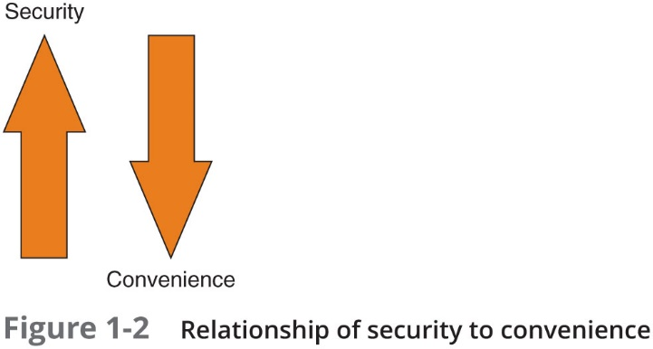
Understanding Security
Security is:
To be free from danger is the goal
The process that achieves that freedom
As security is increased, convenience is often decreased
The more secure something is, the less convenient it may become to use

Slide 9
Defining Information Security (1 of 4)
Information security - the tasks of securing information that is in a digital format: ( Protect data in digital format )
Manipulated by a microprocessor
Preserved on a storage device
Transmitted over a network
Information security goal - to ensure that protective measures are properly implemented to ward off attacks and prevent the total collapse of the system when a successful attack occurs

Slide 10
Defining Information Security (2 of 4)
Three types of information protection (often called C I A) :
Confidentiality
Only approved individuals may access information
Integrity
Information is correct and unaltered
Availability
Information is accessible to authorized users

Slide 11
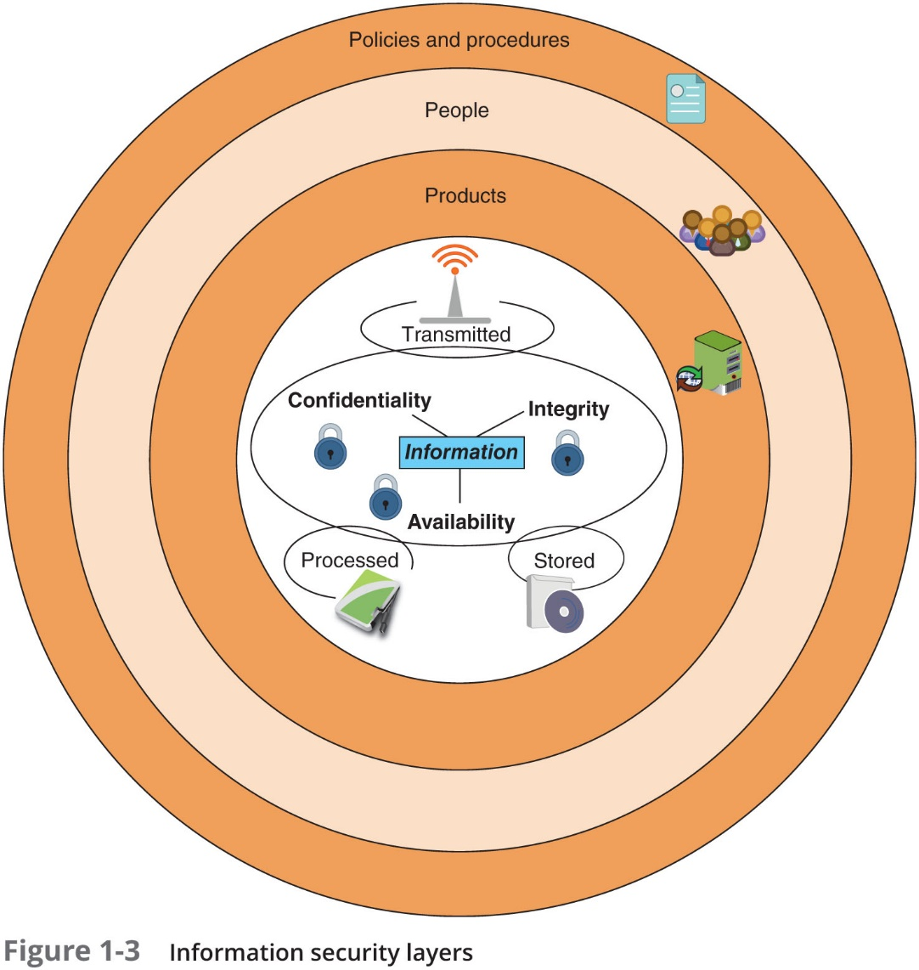
Defining Information Security (3 of 4)

Slide 12
Defining Information Security (4 of 4)
Layer | Description
Products | Form the security around the data. May be as basic as door locks or as complicated as network security equipment.
People | Those who implement and properly use security products to protect data.
Policies and procedures | Plans and policies established by an enterprise to ensure that people correctly use the products.

Slide 13
Breach of Security : An example
Watch the online video : http://www.youtube.com/watch?v=QpUjW64McoM
The video illustrated that some digital copier or printer has a Hard Drive in it. This means that all data printed, scanned, emailed, faxed or copied is stored on that Hard Drive and could potentially be accessed by a unauthorized personnel (especially so if the printer/copier is shared).

Slide 14
Information Security Terminology (1 of 4)
Asset
Item that has value
Threat
Type of action that has the potential to cause harm
Threat actor
A person or element with power to carry out a threat

Slide 15
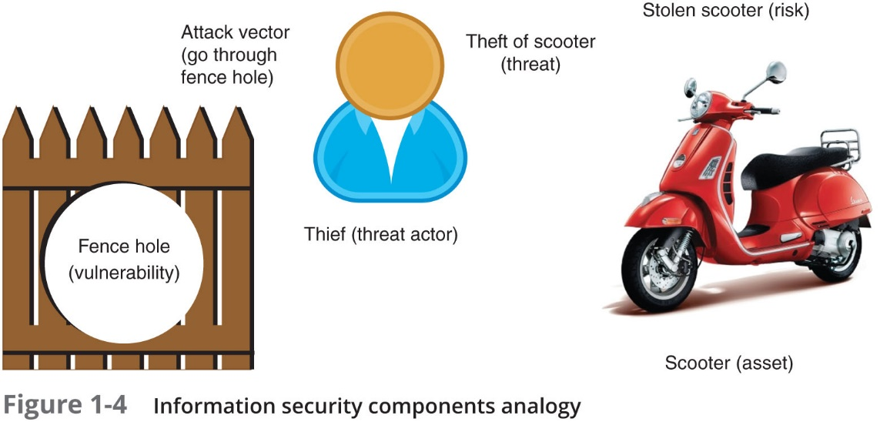
Information Security Terminology (2 of 4)

Slide 16
Information Security Terminology (3 of 4)
Vulnerability
Flaw or weakness that allows a threat agent to bypass security
Threat vector
The means by which an attack can occur
Risk ( Threat vector + vulnerability )
A situation that involves exposure to some type of danger
Risk response techniques:
Accept – risk is acknowledged but no steps are taken to address it
Transfer – transfer risk to a third party ( e.g. Laptop warranty , insurance )
Avoid – identifying risk but making the decision to not engage in the activity
Mitigate – attempt to address risk by making the risk less serious

Slide 17
Information Security Terminology (4 of 4)
Term | Example in Scooter scenario | Example in information security
Asset | Scooter | Employee database
Threat | Steal scooter | Steal data
Threat actor | Thief | Attacker, hurricane
Vulnerability | Hole in fence | Software defect
Attack vector | Climb through hole in fence | Access web server passwords through flaw in operating system
Likelihood | Probability of scooter stolen | Likelihood of virus infection
Risk | Stolen scooter | Virus infection or stolen data

Slide 18
Understanding the Importance of Information Security
Information security can be helpful in:
Preventing data theft
Thwarting identity theft
Avoiding the legal consequences of not securing information
Maintaining productivity
Foiling cyberterrorism

Slide 19
Preventing Data Theft
Preventing data from being stolen is often the primary objective of an organization’s information security
Enterprise data theft involves stealing proprietary business information
Personal data theft involves stealing credit card numbers

Slide 20
Thwarting Identity Theft (Stop identity theft)
Identity theft
Stealing another person’s personal information
Usually using it for financial gain
Example:
Steal person’s S S N ( IC Number )
Create new credit card account to charge purchases and leave them unpaid
File fraudulent tax returns

Slide 21
Avoiding Legal Consequences
Laws protecting electronic data privacy:
The Health Insurance Portability and Accountability Act of 1996 (H I P A A)
The Sarbanes-Oxley Act of 2002 (Sarbox)
The Gramm-Leach-Bliley Act (G L B A)
Payment Card Industry Data Security Standard (P C I D S S)
State notification and security laws
California’s Database Security Breach Notification Act (2003)

Slide 22
Avoiding Legal Consequences
Singapore Laws:
Data Privacy – the Personal Data Protection Act 2012
Cybersecurity – the Cybersecurity Act 2018
Cybercrime – the Computer Misuse Act (Cap. 50A)
Disclaimer: Strictly for educational purposes.
Indemnity: We (SP) will not be responsible for your action. You will keep the Singapore Polytechnic, its management, and servants fully indemnified against all claims, loss or damage whatsoever in respect of death, injury, disability or any loss or damage whatsoever arising from any cause in connection with the module/programme.

Slide 23
Maintaining Productivity
Post-attack clean up diverts resources away from normal activities
Time, money, and other resources
Table 1-6 shows the cost of attacks
Number of total employees | Average hourly salary | Number of employees to combat attack | Hours required to stop attack and clean up | Total lost salaries | Total lost hours of productivity
100 | $25 | 1 | 48 | $4066 | 81
250 | $25 | 3 | 72 | $17,050 | 300
500 | $30 | 5 | 80 | $28,333 | 483
1000 | $30 | 10 | 96 | $220,000 | 1293

Slide 24
Foiling Cyberterrorism
Cyberterrorism
Any premeditated, politically motivated attack against information, computer systems, computer programs, and data
Designed to:
Cause panic
Provoke violence
Result in financial catastrophe
May be directed at targets such as the banking industry, military installations, power plants, air traffic control centers, and water systems

Slide 25
Who Are the Threat Actors?
Threat actor – a generic term used to describe individuals who launch attacks against other users and their computers
Most have a goal of financial gain
Financial cybercrime is often divided into two categories:
First category focuses on individuals as the victims
Second category focuses on enterprises and government
Different groups of threat actors can vary widely, based on:
Attributes
Funding and resources
Whether internal or external to the enterprise or organization
Intent and motivation

Slide 26
Script Kiddies (1 of 2)
Script kiddies - individuals who want to attack computers yet they lack the knowledge of computers and network needed to do so
They download automated hacking software (scripts) from websites
Over 40 percent of attacks require low or no skills

Slide 27
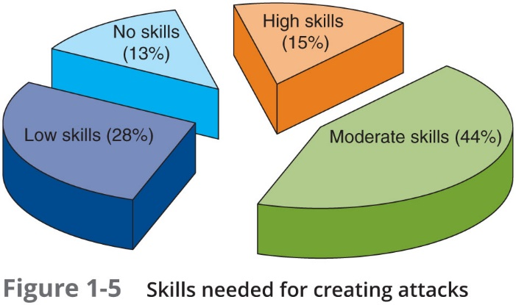
Script Kiddies (2 of 2)

Slide 28
Hactivists
Hactivists - attackers who attack for ideological reasons that are generally not as well-defined as a cyberterrorist’s motivation
Examples of hactivist attacks:
Breaking into a website and changing the contents on the site to make a political statement
Disabling a website belonging to a bank because the bank stopped accepting payments that were deposited into accounts belonging to the hactivists

Slide 29
Nation State Actors
Nation state actor - an attacker commissioned by the governments to attack enemies’ information systems
May target foreign governments or even citizens of the government who are considered hostile or threatening
Known for being well-resourced and highly trained
Advanced Persistent Threat (A P T) - multiyear intrusion campaign that targets highly sensitive economic, proprietary, or national security information

Slide 30
Insiders
Employees, contractors, and business partners
Over 58 percent of breaches attributed to insiders
Examples of insider attacks:
Health care worker may publicize celebrities’ health records
Disgruntled over upcoming job termination
Stock trader might conceal losses through fake transactions
Employees may be bribed or coerced into stealing data before moving to a new job

Slide 31
Other Threat Actors
Threat Actor | Description | Explanation
Competitors | Launch attack against an opponent’s system to steal classified information | Competitors may steal new product research or list of current customers to gain a competitive advantage
Organized crime | Moving from traditional criminal activities to more rewarding and less risky online attacks | Criminal networks are usually run by a small number of experienced online criminal networks who do not commit crimes themselves but act as entrepreneurs
Brokers | Sell their knowledge of a vulnerability to other attackers or governments | Individuals who uncover vulnerabilities do not report it to the software vendor but instead sell them to the highest bidder
Cyberterrorists | Attack a nation’s network and computer infrastructure to cause disruption and panic among citizens | Targets may include a small group of computers or networks that can affect the largest number of users, such as the computers that control the electrical power grid of a state or region

Slide 32
Defending Against Attacks
Five fundamental security principles for defenses:
Layering
Limiting
Diversity
Obscurity
Simplicity

Slide 33
Layering
Information security must be created in layers
A single defense mechanism may be easy to circumvent
Making it unlikely that an attacker can break through all defense layers
Layered security approach (also called defense-in-depth)
Can be useful in resisting a variety of attacks
Provides the most comprehensive protection

Slide 34
Limiting
Limiting access to information:
Reduces the threat against it
Only those who must use data should be granted access
Should be limited to only what they need to do their job
Methods of limiting access
Technology-based - such as file permissions
Procedural - such as prohibiting document removal from premises

Slide 35
Diversity
Closely related to layering
Layers must be different (diverse)
If attackers penetrate one layer:
Same techniques will be unsuccessful in breaking through other layers
Breaching one security layer does not compromise the whole system
Example of diversity
Using security products from different manufacturers
Groups who are responsible for regulating access (control diversity) are different

Slide 36
Obscurity
Obscuring inside details to outsiders
Example: not revealing details
Type of computer
Operating system version
Brand of software used
Difficult for attacker to devise attack if system details are unknown

Slide 37
Simplicity
Nature of information security is complex
Complex security systems:
Can be difficult to understand and troubleshoot
Are often compromised for ease of use by trusted users
A secure system should be simple from the inside
But complex from the outside

Slide 38
Frameworks and Reference Architectures
Industry-standard frameworks and reference architectures
Provide a resource of how to create a secure IT environment
Give an overall program structure and security management guidance to implement and maintain an effective security program
Various frameworks/architectures are specific to a particular sector (industry-specific frameworks)
Such as the financial industry
Some frameworks/architectures are domestic
While other s are world wide

Slide 39
Chapter Summary (1 of 2)
Information security attacks have grown exponentially in recent years
There are many reasons for the high number of successful attacks
It is difficult to defend against today’s attacks
Information security protects information’s integrity, confidentiality, and availability:
On devices that store, manipulate, and transmit information
Using products, people, and procedures

Slide 40
Chapter Summary (2 of 2)
Main goals of information security
Prevent data theft
Thwart identity theft
Avoid legal consequences of not securing information
Maintain productivity
Foil cyberterrorism
Threat actors fall into several categories and exhibit different attributes
Although multiple defenses may be necessary to withstand the steps of an attack, these defenses should be based on five security principles:
Layering, limiting, diversity, obscurity, and simplicity

